Slide 1
Lecture 3 – Serial Communication
This lecture will cover using UART, i2C and SPI to talk to different devices.

Slide 2
Online Slides and sheets
http://goscik.com/Arduino
Slides will go up after a session to discourage Copy & Paste

Slide 3

UARt – Talking WITH a PC
The Arduino has a built in USB to Serial chip built it. This is what allows you to program it without special hardware. It can also be used to send data to and from a PC (or various other devices e.g. a Wi-Fi module). This feature is very useful when debugging code that isn’t working as you expected.
void setup() {
// Start the serial at a speed of 9800 baud
Serial.begin(9800);
}
void loop() {
Serial.println("Hello! What's your name?");
while (Serial.available() == 0 ) {} //Wait for reply
delay(100); // Ensure the whole message has arrived
Serial.print("Hello there "); // Prints out input letter by letter
for (int i=Serial.available(); i>0; i-=1 )
{
char input = Serial.read();
Serial.print(input);
}
Serial.println("!");
}
Notes:
Explain print vs println
Show a live demo of the serial monitor

Slide 4
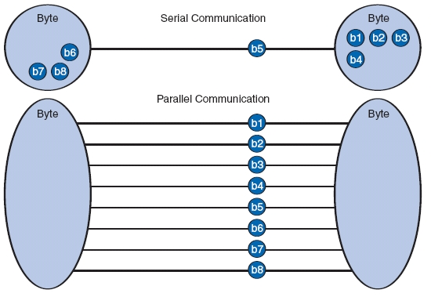
Serial vs Parallel
There are two ways to transfer data: In parallel or in serial. The UART we just used as well SPI and I2C that we will move onto next are all forms of serial data transfer. The data is sent bit by bit across a single channel. In parallel transfer all bits of the message are sent at once across multiple connections.
Serial connections are cheaper to implement than parallel interfaces and have become the preferred from in recent times (USB, SATA).

Slide 5
Binary - 111100010101001010100011011101
In binary you count using 0’s and 1’s. This is very useful in electronics because these can be represented by an open and a closed switch.
In decimal this is: 203
Each 1 or 0 is called a bit, 4 bits = nibble, 8 bits = byte and 16 bits = word
2^{N} | 128 | 64 | 32 | 16 | 8 | 4 | 2 | 1
X | 1 | 1 | 0 | 0 | 1 | 0 | 1 | 1

Slide 6
Binary Shift
It can often be useful to shift the bits in a binary value left or right. This can be done using the “<<“ and “>>” operators respectively.
E.g 10011011 >> 2
This feature will be used in the next two sketches
128 | 64 | 32 | 16 | 8 | 4 | 2 | 1
1 0 0 1 1 0
0 0
1 1

Slide 7
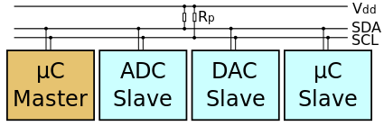
I²C - Inter-Integrated Circuit
Like UART, I2C is a serial data transfer protocol. Unlike UART I2C has many more features that make it more like a computer network.
All devices share a synchronising clock signal (SCL)
All devices talk over a single data line (SDA)
Devices are identified by their address on the bus
There can be multiple “Master” devices and multiple “Slave” devices
Communication can occur using only three wires: Data, Clock and Ground
(Potentially 2 if the devices already share a common ground)

Slide 8
I²C Temperature sensor – LM75A
I2C is another way to transfer serial data. It only uses 3 lines: Data, Clock and Ground
The LM75A sends its temperature across two bytes in this format:
To get this as a single value we need to read byte 1, shift it left by 8, add byte 2 and finally shift right by 5.
Byte\Bit | 7 | 6 | 5 | 4 | 3 | 2 | 1 | 0
1 | T10 | T9 | T8 | T7 | T6 | T5 | T4 | T3
2 | T2 | T1 | T0 | X | X | X | X | X
15 | 14 | 13 | 12 | 11 | 10 | 9 | 8 | 7 | 6 | 5 | 4 | 3 | 2 | 1 | 0
T10 T9 T8 T7 T6 T5 T4 T3
T2 T1 T1 T0
X X X X
Notes:
Mention that both i2c and spi code assume temperature is possitive

Slide 9
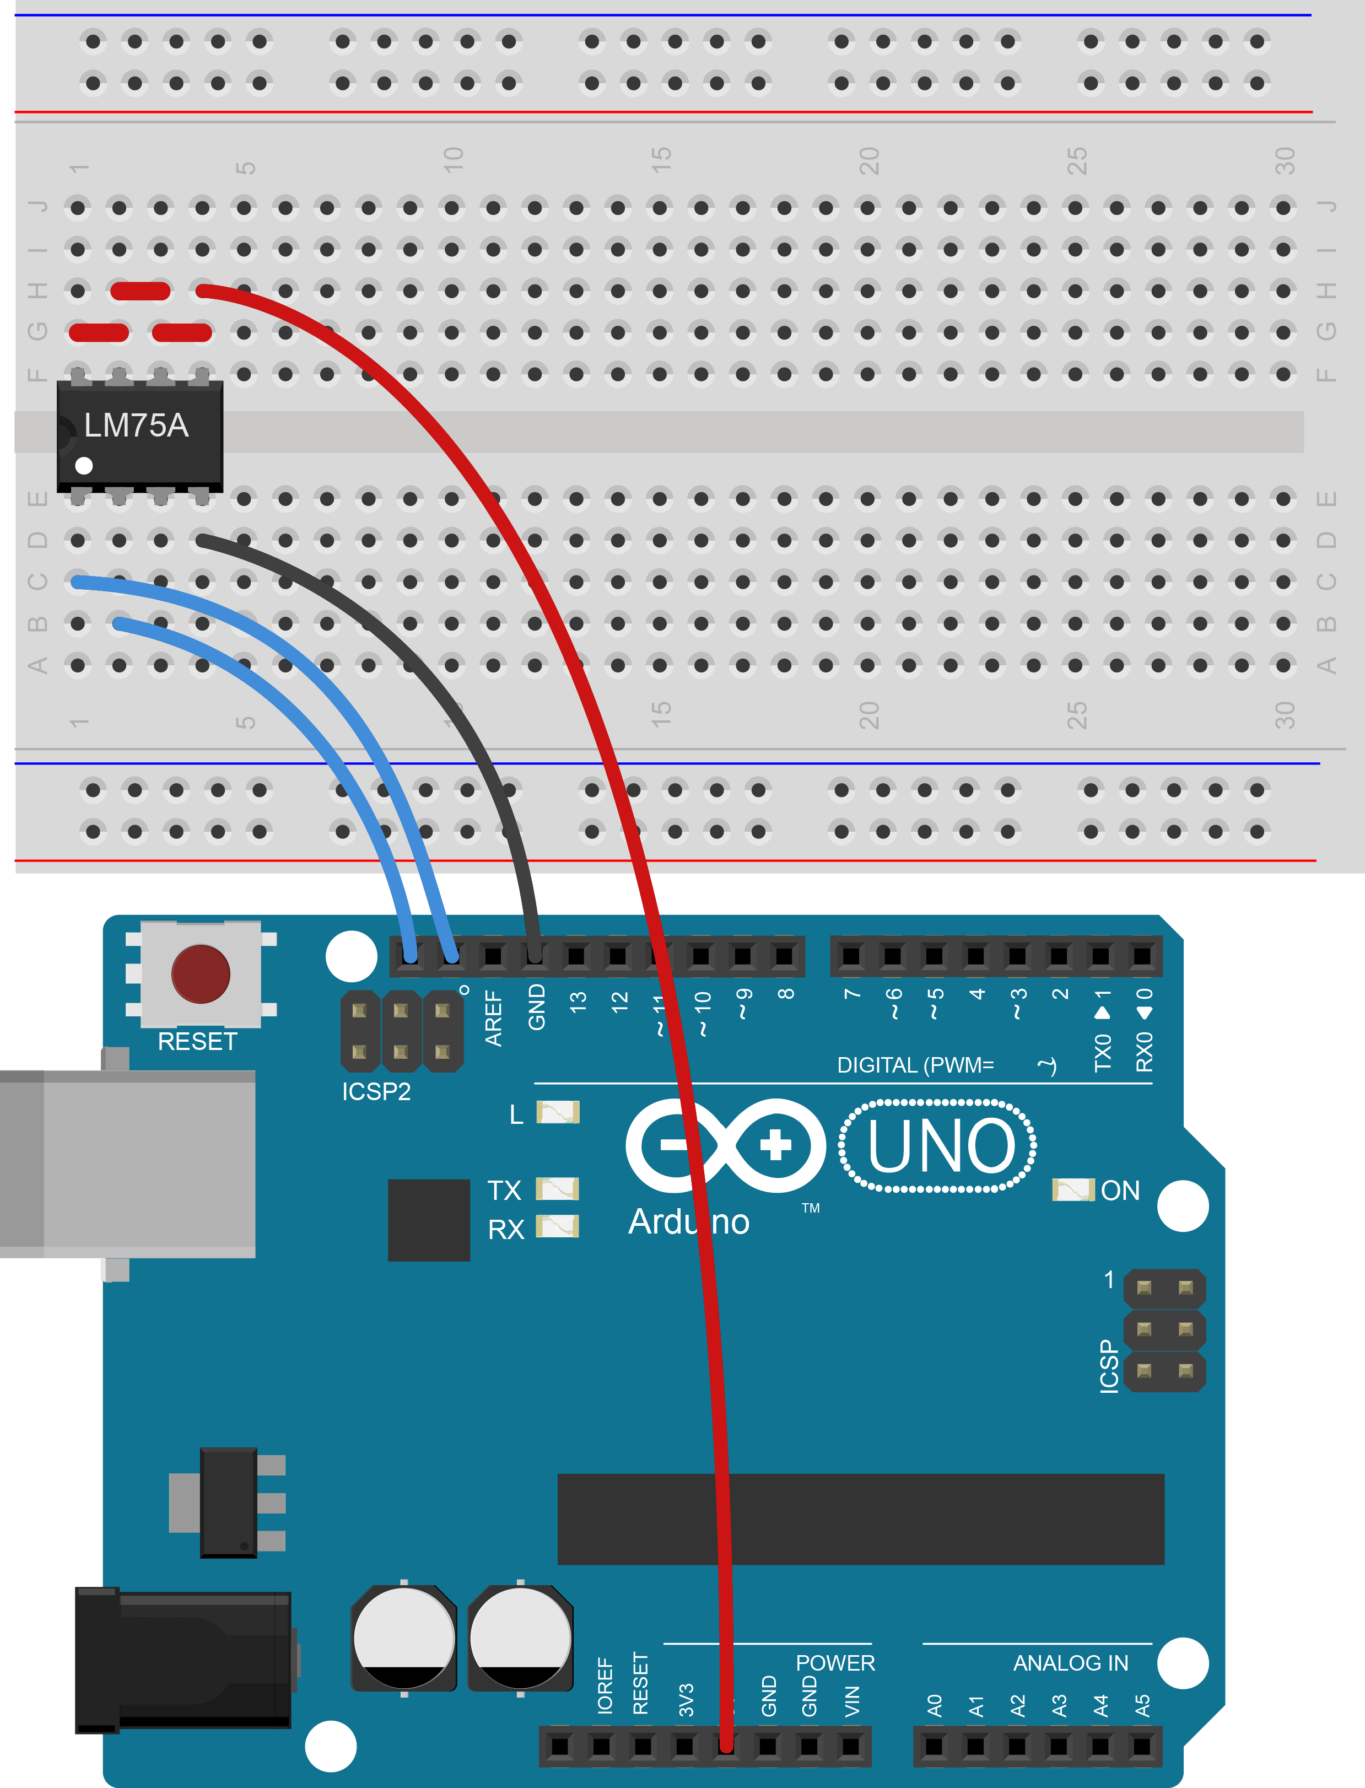
I²C Temperature sensor – LM75A
#include <Wire.h>
const int device_address = 0x4F;
void setup() {
Serial.begin(9600);
Wire.begin();
}
void loop() {
// Ask the sensor for the temp (2 bytes)
Wire.requestFrom(device_address, 2);
// Turn two bytes into one value
word temp = (Wire.read() << 8) + Wire.read();
// remove unwanted data
temp = temp >> 5;
// Convert into degrees C and display
Serial.println(temp * 0.125);
}
Notes:
Mention that both i2c and spi code assume temperature is possitive

Slide 10
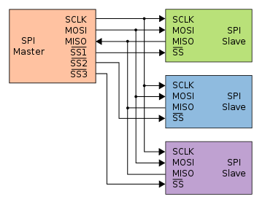
SPI - Serial Peripheral interface
Much like I2C, SPI is a serial data protocol. Unlike I2C it only supports a single “Master device” and each “Slave” device needs a Slave Select (SS) pin on the master instead of an address. Another difference is that there are two unidirectional data lines, Master out, Slave in (MOSI) and Master in, Slave out (MISO). These differences mean that it is a much simpler interface to implement.

Slide 11
A Cautionary Tale
Sadly some terms like I2C are trademarked and can be referred to by many different names. Sometimes the same name is used to mean different things.
In our case we fell prey to marketing BS. The SPI sensors we have are marketed as SPI but are actually something called Microwire. This is similar to SPI but the MOSI and MISO pins are multiplexed. The sensor sends 16 bits then reads 16 bits.
This means we can’t use the Arduino libraries to interface with the sensor. Luckily SPI is really simple to “bit bang” (do things manually).

Slide 12
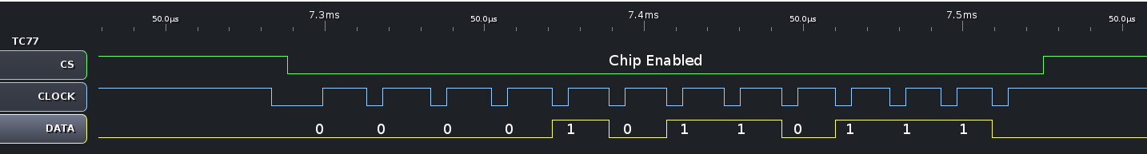
TC77 Explained
Because we simply need to read the temperature from the sensor and not worry about configuring its extra features the process is very simple (Both the LM75A and TC77 are designed to act as thermal cut off switches). The TC77 transmits 16 bits then reads 16 bits. We only need to worry about the first 12 bits it sends because like the LM75A the last few bits are garbage. The process for reading the chip is:
Ensure the clock pin is LOW
Make the chip select (CS) pin LOW, this enables the sensor
We now have to produce a square wave on the clock (SLC) line by toggling it HIGH
After each rising edge of the clock (from LOW to HIGH) we need to read the data pin (SDA)
Once we have finished reading we need to return the clock to LOW
We need to repeat this sampling process 12 times
Once we have completed we put chip select back to HIGH

Slide 13
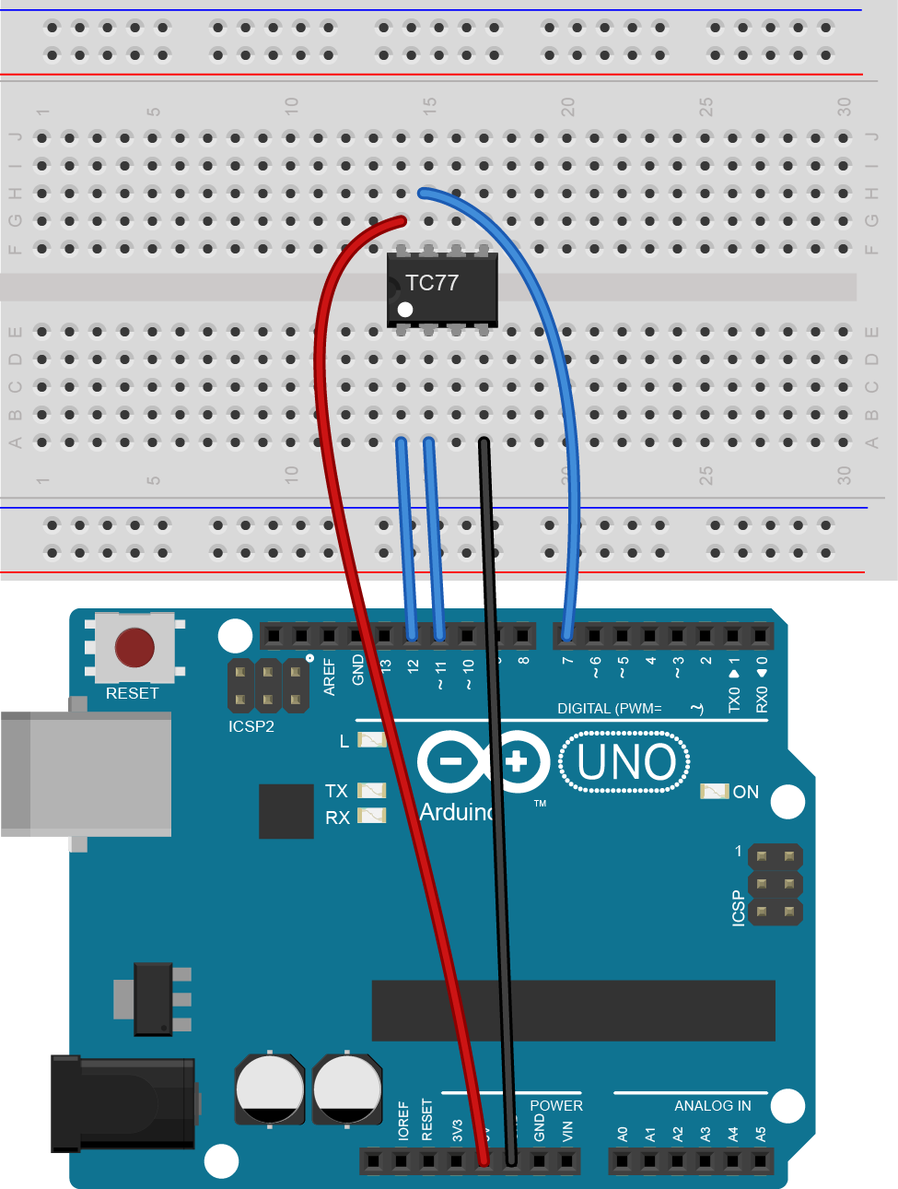
SPI (sort of) Temperature sensor
const int slaveSelectPin = 7;
const int clockPin = 11;
const int dataPin = 12;
void setup() {
pinMode(clockPin, OUTPUT);
pinMode(slaveSelectPin, OUTPUT);
pinMode(dataPin, INPUT);
Serial.begin(9600);
}
void loop() {
int data = 0;
digitalWrite(clockPin, LOW); // Start with clock low
digitalWrite(slaveSelectPin, LOW); // Start transfer by setting CS=LOW
for (int i = 12; i>=0; i-=1) { // Read the next 12 bits
digitalWrite(clockPin, LOW); // Clock pulse
digitalWrite(clockPin, HIGH);
data += (digitalRead(dataPin) << i); // Read in value
}
digitalWrite(slaveSelectPin, HIGH); // Finish transfer
Serial.println(data*0.0625);
}

Slide 14
Challenges
Make a “touch” detector
Make an RGB LED fade red or blue depending on temperature
ADVANCED CHALLEGNGE:
Look up the data sheet for the I2C sensor and see if you can make the over temperature function work
http://www.nxp.com/documents/data_sheet/LM75A.pdf

